Slide 1
Emotion Regulatory Strategies Beyond the Lab: Findings from “Terror Behind the Walls”
Billy Mitchell
First-Year Presentation
April 20th, 2020
Notes:
Thank you all for signing on today for our talks. To start, I want to present a scenario.

Slide 2
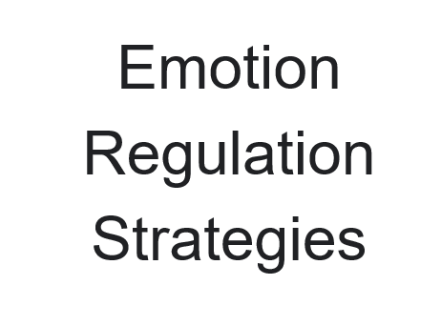

Cognitive Change
Attentional Deployment
Situation Modification
“I’m not going out to eat; I’m going out to see my friends”
“I can try to just focus on the conversation, rather than the food.”
“I could order something healthy from the menu.”
Maximize
Enjoyment
Minimize
Anxiety
Situation Selection
Response Modulation
“I should just stay home and not go.”
“I should just eat pizza and
not care about my weight.”
Notes:
Imagine that a friend that you haven’t talked to in a long time calls you out of the blue. They’re in town with some other friends of yours and you really want to see them all, but they’re heading to one of the greasiest restaurants around. The thought of going gives you a little anxiety, because you’ve been doing so well with your weight loss and the temptation might knock you off-track. In this scenario, you might say that you have two goals:
to maximize time spent with friends while minimizing the anxiety that you feel about it. To achieve these goals, you might consider a few options.
Perhaps you recontextualize the situation, and you think to yourself, “I’m not going out to eat; I’m spending time with my friends.”
Perhaps you decided that you can just focus on how much you enjoy being around your friends rather than how badly you want that food.
You could also decide that you’ll go, but that you’ll go against the grain and order something healthy.
You could decide that the anxiety of avoiding comfort food isn’t worth the stress and stay home while making plans to meet at a future date.
Or you can lie to yourself and say that your weight isn’t that important to you. What all of these options have in common
is that they are examples of common strategies
cited by emotion regulation researchers.

Slide 3
Emotion Regulation
The processes by which we influence which emotions we have, when we have them, and how we experience and express them. ¹
Strategies consist of behavioral and cognitive responses to emotionally-valenced stimuli in order to minimize and maximize emotional reactions in accordance with emotional goals.
Excitement
PRESENTING WORK
SALIENT EVENT
Anxiety
¹ Gross, (1998).
Notes:
Broadly, Emotion Regulation is the processes by which we influence which emotions we have, when we have them, and how we experience and express them.
Emotional Regulation strategies consist of behavioral and cognitive responses to emotionally-valenced stimuli in order to minimize and maximize emotional reactions in accordance with emotional goals.
Let’s use another example to demonstrate. Say you experience an emotionally salient event:
perhaps presenting your years’ work for consideration to the psychology department.
You might feel both anxiety and excitement at the proposition,
but the anxiety might heavily overshadow any excitement that you might feel, which is probably not in line with our larger goals.

Slide 4
Emotion Regulation
The processes by which we influence which emotions we have, when we have them, and how we experience and express them. ¹
Strategies consist of behavioral and cognitive responses to emotionally-valenced stimuli in order to minimize and maximize emotional reactions in accordance with emotional goals.
Excitement
Excitement
PRESENTING
WORK
REGULATION STRATEGY
Anxiety
Anxiety
¹ Gross (1998).
Notes:
The appropriate regulation strategy serves to
rebalance those emotions in line with an individual’s larger emotional goals.

Slide 5
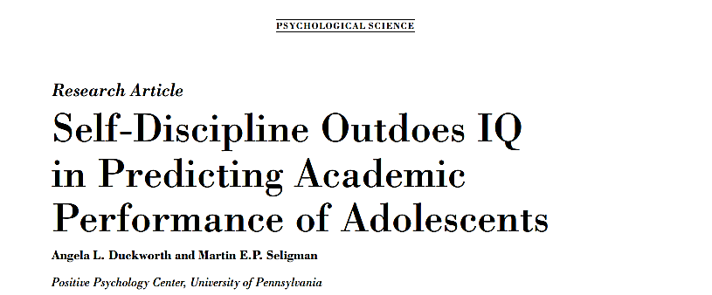
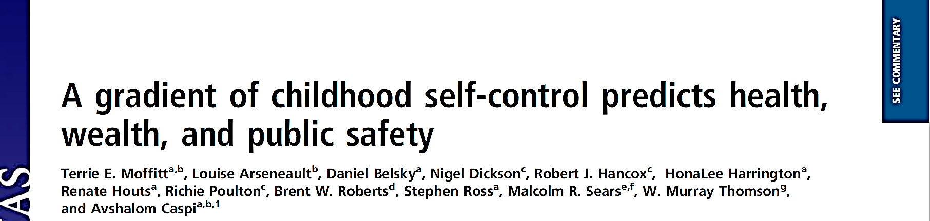
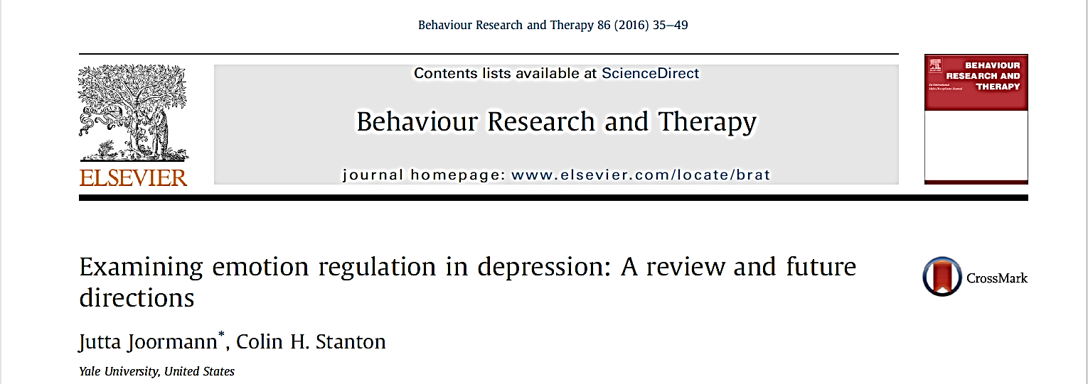
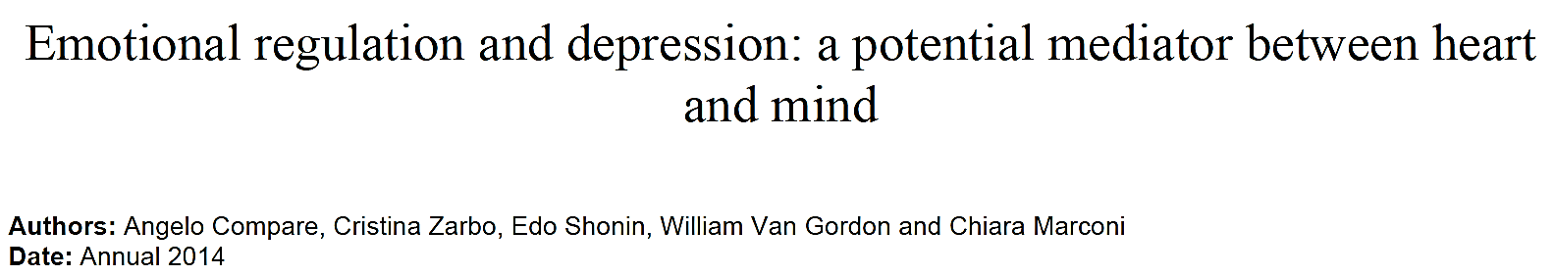
¹ Duckworth & Seligman (2005); ² Moffit et al. (2011); ³ Joorman et al. (2016); ⁴ Compare et al. (2014).
Notes:
There’s a robust literature linking implementation of regulation strategies to variances in academic performance, health outcomes, economic achievement, and mental well-being. Emotion regulation has enjoyed its fair share of attention in the literature because of its connection to these real-world outcomes. However, when we look a little deeper….

Slide 6

Notes:
We see that we know little about how emotion regulation functions in the real world. Prior research directly instructed participants to use specific strategies to modify emotions. We still don’t understand how and how often individuals spontaneously regulate their emotions. There’s been a sizeable amount of research in the past few years in unguided emotion regulation, though.

Slide 7
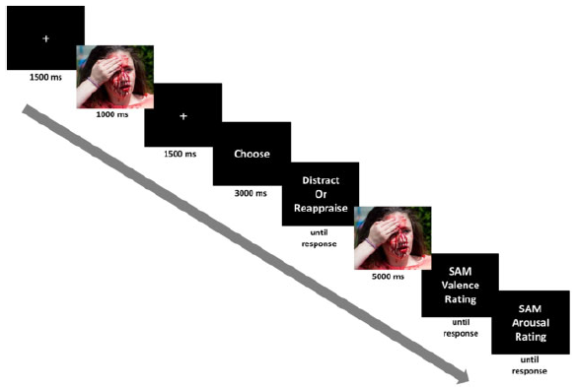
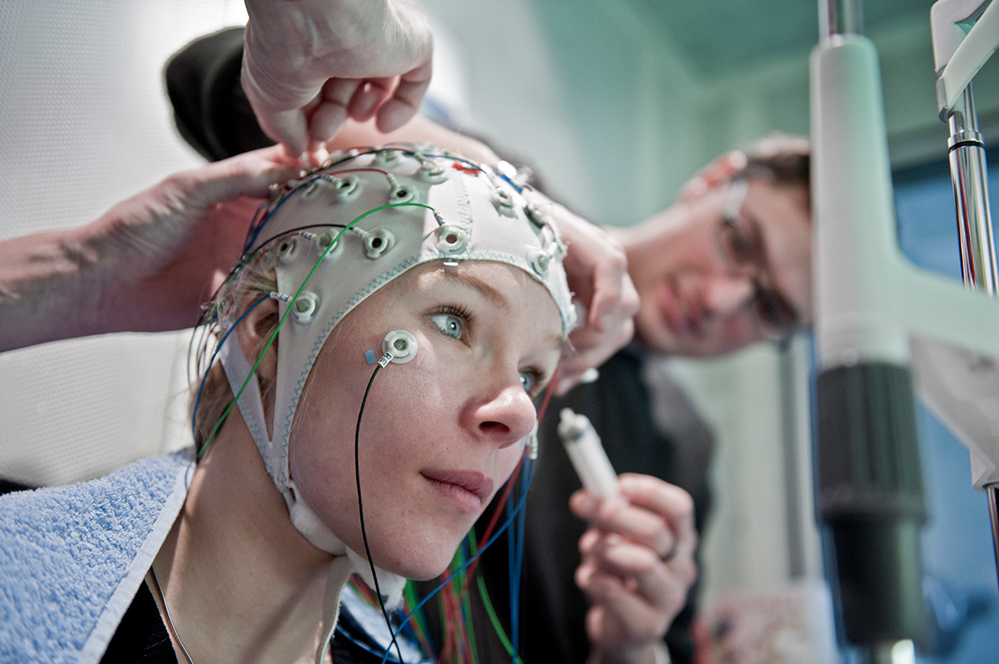
A Common Modern Emotion Regulation Experimental Design ¹
¹ Shafir et al., (2016).
Notes:
Here’s a quick example of an experimental paradigm used by Tal Shafir and her coauthors.
Participants were connected to an EEG
and presented with emotionally-valenced stimuli from the IAPS pictoral set . The images were of random intensity.
After being..

Slide 8
A Common Modern Emotion Regulation Experimental Design ¹
¹ Shafir et al., (2016).
Notes:
After being trained in both available strategies, Participants chose whichever strategy that they wanted to in order to minimize their reactions…
When the picture…

Slide 9
A Common Modern Emotion Regulation Experimental Design ¹
¹ Shafir et al., (2016).
Notes:
when the picture reappeared.
Recordings ….

Slide 10
A Common Modern Emotion Regulation Experimental Design ¹
¹ Shafir et al., (2016).
Notes:
Recordings of emotional intensity were captured after presentation, but because of the temporal resolution of EEG, …

Slide 11
A Common Modern Emotion Regulation Experimental Design ¹
¹ Shafir et al., (2016).
Notes:
researchers were able to capture cognitive processing of subjective emotional intensity throughout the whole process, rather than simply the end point. This represents a strong step forward for the emotion regulation literature.

Slide 12

Limitations
Participants are trained in regulatory strategies and prompted to regulate
Broader population is largely strategy-naïve.
Artificial nature of experimental designs
Findings may not be applicable to emotion regulation outside of the lab
Meta-analyses suggest flaws in common emotion regulation paradigms ¹
Suggests surveys are strong, but tasks lack internal validity
Naturalistic studies limited to Experiential Sampling
Limited in scope, mild emotional experiences
¹ Eisenberg et al. (2019).
Notes:
However, even as great as this is, it still suffers from a few limitations.
Namely, participants are still trained in regulation strategies and prompted to regulate. So we have don’t know if these individuals would use these methods or regulate at all if not instructed to. In the broader population, people likely don’t put much thought into the efficacy of different techniques.
Additionally, the artificial nature of experimental design may result in a lack of external validity to the body of these findings. These undirected strategy designs are likely better models of choice in the wild, but may still fail to model the presentation and cognitive processing of stimuli beyond the lab setting.
Furthermore, meta-analyses suggest these tasks fail to target the same mechanisms across experiments, which causes concern for internal validity. To date, only a handful of researchers have explored these questions outside of a lab setting and many of those have used experiential sampling methods to do so.
These also present a great step forward, but are limited in their ability to capture any emotional events that might rise above a mild intensity level.

Slide 13
Primary Question
How and how often are emotional regulation strategies implemented in the real world?
Notes:
So then, maybe obviously, the next questions are how and how often are emotional regulation strategies implemented in the real world? This past fall, we were able to explore these questions through a collaboration with the Adaptive Memory Lab…

Slide 14
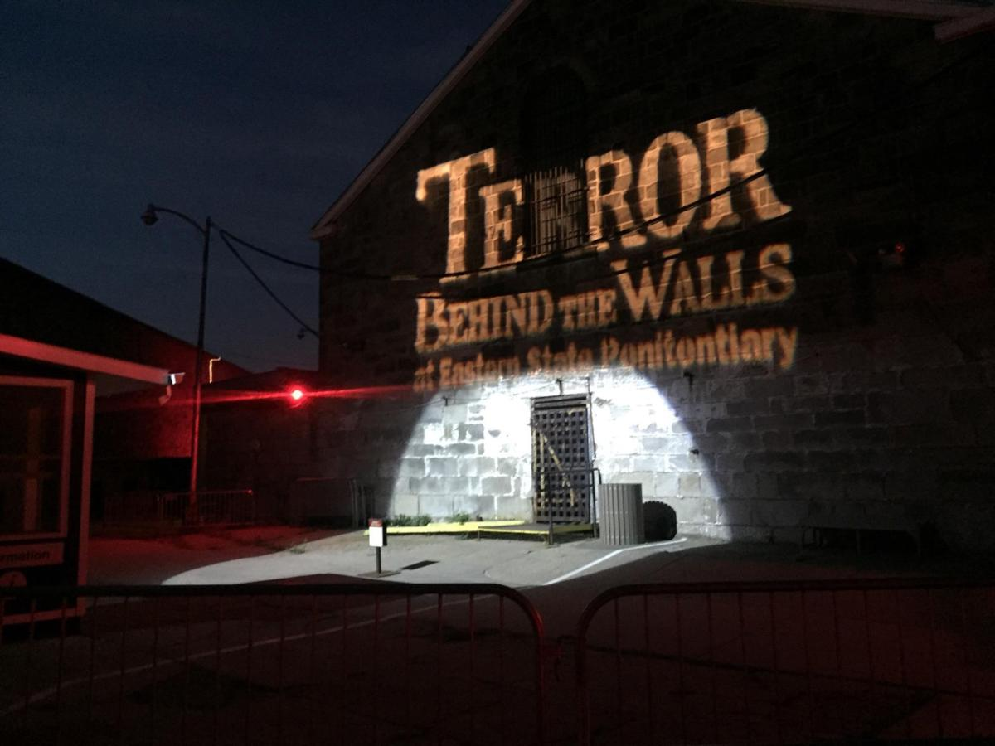

Notes:
Using the well-known haunted house experience called Terror Behind the Walls.
If you’re unfamiliar, Terror Behind the Walls is a yearly event operated within and by the Eastern State Penitentiary here in Philadelphia.
[SKIP BELOW]
It operates throughout October as a means of supplementing the cost to maintain the historical site and the organizers go to tremendous lengths to maintain its renown, hiring hundreds of actors to play the parts of escaped prisoners, guards, and other roles meant to terrify visitors.

Slide 15
Strengths of Terror Behind the Walls
Consistency
Variability in stimuli
Controlled environment
Real World
Really fun design!
-ish
Notes:
Terror Behind the Walls is a fantastic place to explore these questions for a number of reasons.
The directors and actors provide a consistent performance night after night comparable to an experimental design that you might find in any lab. Despite the consistency throughout the experience as a whole,…
there’s a significant amount of stimuli variability within, so it’s nearly guaranteed that some part of the house will induce a response from each participant. Of course, whenever you are asking participants to engage with negatively-valenced stimuli, there’s always the concern of participant safety,…
and Terror Behind the Walls provides a controlled environment where participants can have intense feelings with no real danger present, as well as being readily prepared if things were to take a turn for the worst.
While your everyday life probably doesn’t have jump scares, airguns, and 100 dB ambient drone music, the way that the study was designed might better approximate the real world course of emotional regulation for untrained, strategy-naïve individuals. So it’s maybe still not quite in the “Real World” but it’s at least
“Real World –ish”.
Finally, it was just a really fun experience, not only for participants, but us researchers, too. We completed this whole project in a little over one month, so, it was quite a whirlwind.

Slide 16

Hypotheses
The valence of emotional experiences will trend more positive across events.
Negative emotions are regulated with greater intensity than positive emotions.
The intensity of emotional experiences will decrease across events, independent of valence.
Notes:
Our preliminary analyses focused on exploring three questions. First, we wanted to identify whether the valence of emotional experiences would increase in positivity across events, suggesting that individuals are successfully minimizing negative emotions while maximizing positive ones. Next, we’d posit that negative emotions would be more likely to be regulated than positive ones, suggesting not only that regulation is happening, but highlighting mechanisms behind it. Finally, we wanted to determine whether the intensity of the emotional experience would decrease across events, which would support theories of affective adaptation. So what did this study look like?

Slide 17
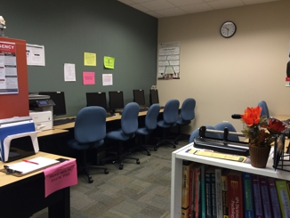

Methods: Pre-Exposure
Sample size = 54
Age: Median = 24 yrs old, Range = 18 - 34 yrs old
Gender: 26 male, 27 female, 1 non-binary
12 groups of 3 to 5 participants (mean group size = 4.5)
AML LAB NOT PICTURED
Notes:
After screening, 54 participants arrived at the
AML lab on a designated date roughly one hour prior to their entrance into Terror Behind the Walls. Upon arrival, participants…

Slide 18
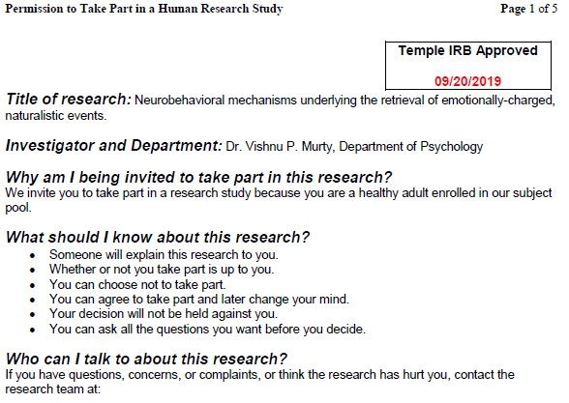


Methods: Pre-Exposure
Sample size = 54
Age: Median = 24 yrs old, Range = 18 - 34 yrs old
Gender: 26 male, 27 female, 1 non-binary
12 groups of 3 to 5 participants (mean group size = 4.5)
Notes:
… were consented
and outfitted with Heartrate monitoring bands on their chests.

Slide 19
Methods: Pre-Exposure
Sample size = 54
Age: Median = 24 yrs old, Range = 18 - 34 yrs old
Gender: 26 male, 27 female, 1 non-binary
12 groups of 3 to 5 participants (mean group size = 4.5)
Pre-Exposure Tasks:
Heartrate Monitoring
Computer-based questionnaires
Recording devices
AML LAB STILL NOT PICTURED
Notes:
Participants were then instructed to complete computer-based questionnaires while baseline heartrate measurements were taken. Heartrate data continued to be collected until participation ended for this session.

Slide 20
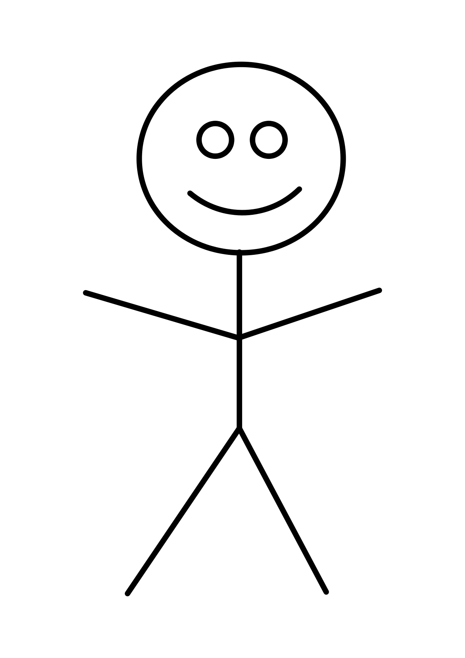

Methods: Pre-Exposure
Sample size = 54
Age: Median = 24 yrs old, Range = 18 - 34 yrs old
Gender: 26 male, 27 female, 1 non-binary
12 groups of 3 to 5 participants (mean group size = 4.5)
Pre-Exposure Tasks:
Heartrate Monitoring
Computer-based questionnaires
Recording devices
AML LAB STILL NOT PICTURED
#1
#2
Notes:
After all questionnaires were completed,
participants were also outfitted with personal audio recording devices that would be actively recording throughout the night.
Participants were in groups as small as three but as large as five and were accompanied by
two trained researchers.

Slide 21
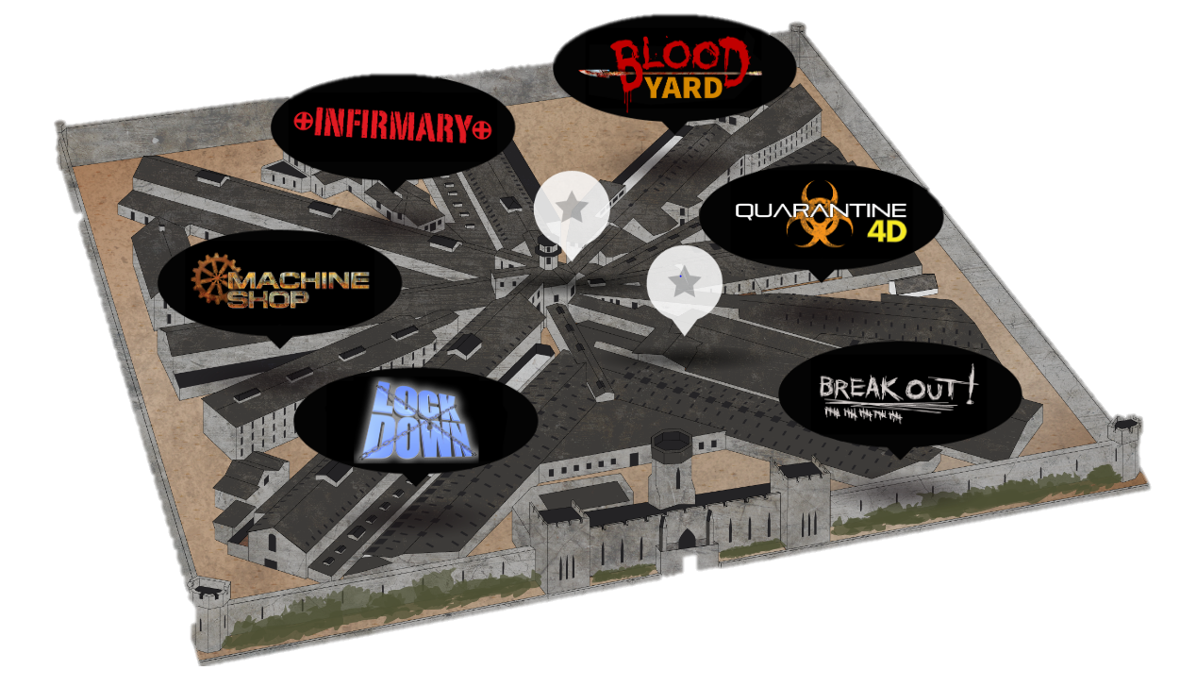

Methods: Pre-Exposure and Exposure
Sample size = 54
Age: Median = 24 yrs old, Range = 18 - 34 yrs old
Gender: 26 male, 27 female, 1 non-binary
12 groups of 3 to 5 participants (mean group size = 4.5)
Pre-Exposure Tasks:
Heartrate Monitoring
Computer-based questionnaires
Recording devices
Facility thematically segmented
Six segments in total; Participants took turns leading
Exposure = 30 mins.
#1
#2
Notes:
Upon arrival to Eastern State, participants were instructed to remain with the group and details about participation were provided, notably that the haunted house experience was divided into
six segments.
One researcher waited outside of the facility
The other joined
the group throughout the house while continuing to
record heart rate data and keeping the group on task. Given that there were then, ideally six members of the group,
a different member of the group was randomly assigned to lead the group through each section, such that everyone lead once.

Slide 22
Methods: Pre-Exposure and Exposure
Sample size = 57
Age: Median = 24 yrs old, Range = 18 - 34 yrs old
Gender: 26 male, 30 female, 1 non-binary
12 groups of 3 to 5 participants (mean group size = 4.5)
Pre-Exposure Tasks:
Heartrate Monitoring
Computer-based questionnaires
Recording devices
Facility thematically segmented
Six segments in total; Participants took turns leading
Exposure = 30 mins.
My fear rating for this section was a
4 out of 5.
Notes:
At the end of each section, participants recorded fear ratings into their microphones.
From the time it took to enter the first section until participants exited the final section, the average time through the house was only about 30 minutes.
At the end of the experience, participants were instructed to return all equipment
and to not discuss their experience with anyone.

Slide 23
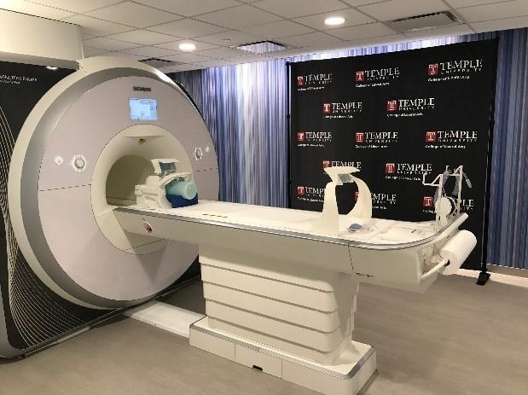
Methods: Post- Exposure
Post – Exposure ( 7 days after)
Mean = 6.93 days, Range = 5.75 - 8.13 days
Post-Exposure Tasks:
MRI Free-Recall
Computer-Based Questionnaires
STILL NOT AML LAB
ACTUALLY TUBRIC
Notes:
Roughly one week after exposure, participants were brought back into the lab
for an MRI free-recall memory task which took roughly one hour. Afterwards, participants were asked to complete another set of
computer-based questionnaires before being paid and released from study participation.

Slide 24
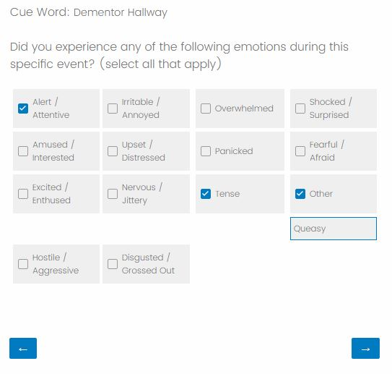
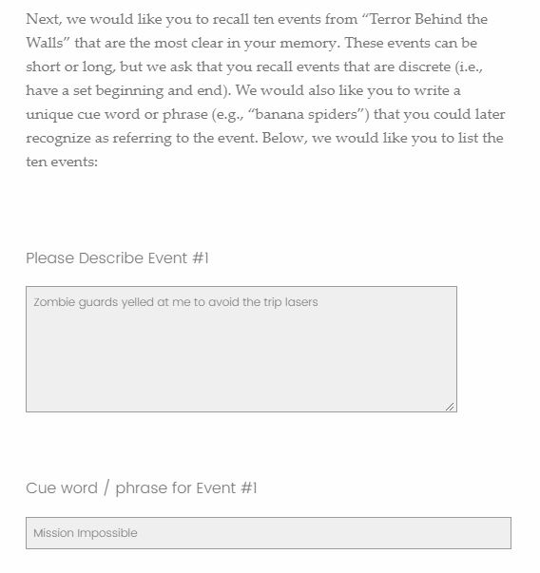
Measures
Event Experience and Ordering Questionnaire
Identify 10 events
Identify associated emotions
Notes:
During the post-exposure session, participants were asked to identify and describe 10 emotionally salient and temporally discrete events from within the haunted house. Illustrated here is an example of a response that people might report. These ten events all occurred within that half-hour haunted house exposure window. After reporting 10 events, participants were asked what emotions they experienced during each event.
You could see here that the Cue Word that they’d entered prepopulated at the top.
And they were free to choose as few or as many emotions as were warranted. The ordering in appearance of the emotions was randomized. These emotion categories were modified from the PANAS, or the Positive and Negative Affect Schedule, which is commonly used in emotion research.

Slide 25
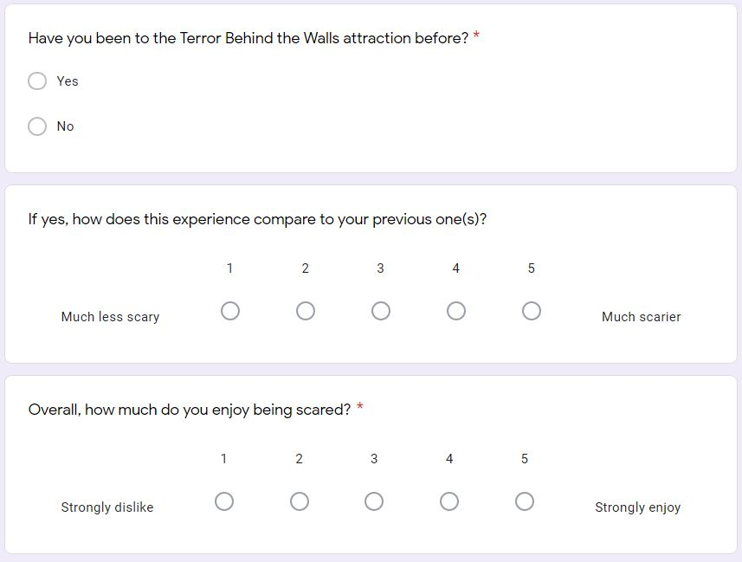
Measures
Event Experience and Ordering Questionnaire
Identify 10 events
Identify associated emotions
Notes:
Measures at this stage included an experiential questionnaire, which captured additional fear-ratings by section, memory details, and an assortment of other useful data such as
past haunted house experiences and preferences.
Additionally, participants were asked to identify and describe 10 emotionally salient and temporally discrete events from within the haunted house. Illustrated here is an example of a response that people might report.
These ten events all occurred within that half-hour haunted house exposure window. After reporting 10 events, participants were asked what emotions they experienced during each event.
You could see here that the Cue Word that they’d entered prepopulated at the top.
And they were free to choose as few emotions or as many as they felt were warranted, in addition to adding a free response if none of the present categories were sufficient and the ordering of appearance was randomized. The categories were modified from the PANAS, or the Positive and Negative Affect Schedule, which is commonly used in emotion research.

Slide 26
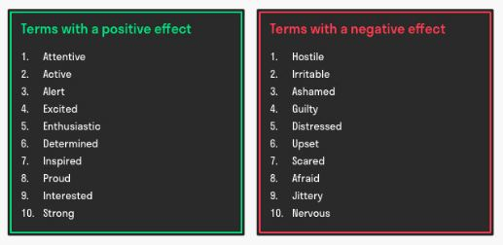
Measures
Notes:
To the right, you can see the emotions captured by the unmodified PANAS. It breaks emotions down into positive and negative valence categories, however,
some emotions weren’t relevant to the experience,
were redundant,
Or were relevant but not capture by the PANAS. And were removed, collapsed, or added as seen fit.
[WAIT BEFORE CLICKING OFF]

Slide 27
Measures
POSITIVE CATEGORIES = 3
α = 0.80
NEGATIVE CATEGORIES = 10
α = 0.91
Event Experience and Ordering Questionnaire
Identify 10 events
Identify associated emotions
Notes:
After settling on our modifications,
we concluded with 3 positively valenced emotion categories and 10 negatively valenced emotion categories. The notable imbalance of positive to negative was a concern while modifying the measure, but given the nature of the semi-naturalistic design, we consider it an unavoidable limitation of the study. These categories were analyzed using a Cronbach’s Alpha after data collection ended and both showed sufficient internal consistency.

Slide 28
Frequency of Emotion Categories Throughout Exposure
Total Emotions Endorsed: 1163
Average Emotions Per Event Per Participant: 2.33
 | Emotion |  | Percentage
 | Amused / Interested | : | 19.60%
 | Alert / Attentive | : | 15.65%
 | Tense | : | 10.23%
 | Fearful / Afraid | : | 9.80%
 | Excited / Enthused | : | 9.72%
 | Nervous / Jittery | : | 9.46%
 | Shocked / Surprised | : | 9.20%
 | Irritable / Annoyed | : | 4.30%
 | Panicked | : | 3.70%
 | Overwhelmed | : | 3.35%
 | Upset / Distressed | : | 2.41%
 | Disgusted/ Grossed Out | : | 2.06%
 | Hostile / Aggressive | : | 0.52%
Notes:
Four participants were removed from analysis due to incomplete datasets. The remaining 50 participants indicated feeling 1163 emotions over the 10 events that they each documented, coming to an average of a little over 2 emotions per event per participant. This does not include “other” emotions, which demand unique classification on a case by case basis, which we haven’t yet performed. Both the table to the right and the pie chart to the left are organized by frequency, with both decreasing as you progress downwards and clockwise, respectively. A few items of note.

Slide 29
Frequency of Emotion Categories Throughout Exposure
Total Emotions Endorsed: 1163
Average Emotions Per Event Per Participant: 2.33
 | Emotion |  | Percentage
 | Amused / Interested | : | 19.60%
 | Alert / Attentive | : | 15.65%
 | Tense | : | 10.23%
 | Fearful / Afraid | : | 9.80%
 | Excited / Enthused | : | 9.72%
 | Nervous / Jittery | : | 9.46%
 | Shocked / Surprised | : | 9.20%
 | Irritable / Annoyed | : | 4.30%
 | Panicked | : | 3.70%
 | Overwhelmed | : | 3.35%
 | Upset / Distressed | : | 2.41%
 | Disgusted/ Grossed Out | : | 2.06%
 | Hostile / Aggressive | : | 0.52%
Notes:
You might notice that the two most frequently cited emotions both are members of the positive valence group.

Slide 30
Frequency of Emotion Categories Throughout Exposure
Total Emotions Endorsed: 1163
Average Emotions Per Event Per Participant: 2.33
 | Emotion |  | Percentage
 | Amused / Interested | : | 19.60%
 | Alert / Attentive | : | 15.65%
 | Tense | : | 10.23%
 | Fearful / Afraid | : | 9.80%
 | Excited / Enthused | : | 9.72%
 | Nervous / Jittery | : | 9.46%
 | Shocked / Surprised | : | 9.20%
 | Irritable / Annoyed | : | 4.30%
 | Panicked | : | 3.70%
 | Overwhelmed | : | 3.35%
 | Upset / Distressed | : | 2.41%
 | Disgusted/ Grossed Out | : | 2.06%
 | Hostile / Aggressive | : | 0.52%
Notes:
Fear was only the fourth most common emotion cited.

Slide 31
Frequency of Emotion Categories Throughout Exposure
Total Emotions Endorsed: 1163
Average Emotions Per Event Per Participant: 2.33
 | Emotion |  | Percentage
 | Amused / Interested | : | 19.60%
 | Alert / Attentive | : | 15.65%
 | Tense | : | 10.23%
 | Fearful / Afraid | : | 9.80%
 | Excited / Enthused | : | 9.72%
 | Nervous / Jittery | : | 9.46%
 | Shocked / Surprised | : | 9.20%
 | Irritable / Annoyed | : | 4.30%
 | Panicked | : | 3.70%
 | Overwhelmed | : | 3.35%
 | Upset / Distressed | : | 2.41%
 | Disgusted/ Grossed Out | : | 2.06%
 | Hostile / Aggressive | : | 0.52%
Notes:
Feelings of being overwhelmed were very low, which was surpri given the massive number of stimuli being presented simultaneously.

Slide 32
Frequency of Emotion Categories Throughout Exposure
Total Emotions Endorsed: 1163
Average Emotions Per Event Per Participant: 2.33
 | Emotion |  | Percentage
 | Amused / Interested | : | 19.60%
 | Alert / Attentive | : | 15.65%
 | Tense | : | 10.23%
 | Fearful / Afraid | : | 9.80%
 | Excited / Enthused | : | 9.72%
 | Nervous / Jittery | : | 9.46%
 | Shocked / Surprised | : | 9.20%
 | Irritable / Annoyed | : | 4.30%
 | Panicked | : | 3.70%
 | Overwhelmed | : | 3.35%
 | Upset / Distressed | : | 2.41%
 | Disgusted/ Grossed Out | : | 2.06%
 | Hostile / Aggressive | : | 0.52%
Notes:
Lastly, feelings of disgust were extremely low as well, despite a generous helping of gore.

Slide 33
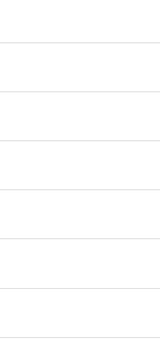
Emotions Endorsed By Valence Group
Notes:
We can also look by valence grouping. On the Y axis, you can see we have the number of times that emotions within a valence group were endorsed.
Although the two most popular emotions were positively valenced, negative emotions overall were still endorsed more often. However, there’s much more to consider than just the presence of certain emotions.

Slide 34
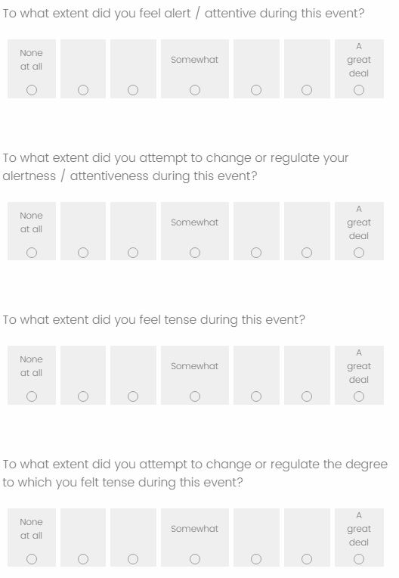
Measures
Event Experience and Ordering Questionnaire
Identify 10 events
Identify associated emotions
Identify intensity of emotion and attempt to regulate
Notes:
In addition to asking participants which emotions that they felt, we also asked to what extent
Did they feel each emotion that they endorsed
And to what extent did they try to regulate each emotion, also.
[PAUSE HERE]

Slide 35
Average Intensity of Emotion Responses By Valence Category
A Great Extent
Not At All
Notes:
On this Y axis here, we see the average intensity of responses with 1 representing not at all and 7 representing A Great Extent.
On average, positive experiences were reported as feeling more intense than negative ones, which is interesting, given, that

Slide 36
Average Intensity of Emotion Responses By Valence Category
Emotions Endorsed By Valence Group
A Great Extent
Not At All
Notes:
They were reported less frequently than the negative ones. Here’s the previously seen frequency chart for reference.

Slide 37
Hypotheses
The valence of emotional experiences will trend more positive across events.
Notes:
Using this data, what did we find for our first hypothesis? In order to calculate that, we had to do a few things.

Slide 38
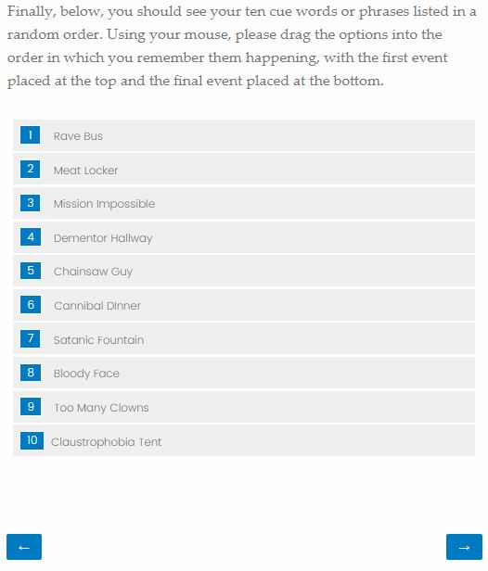
Measures
Event Experience and Ordering Questionnaire
Identify 10 events
Identify associated emotions
Identify intensity of emotion and attempt to regulate
Reorder items chronologically
Notes:
At the end of our ten-event questionnaire, participants were presented with their cue words again in a randomized order and asked to reorder them chronologically.

Slide 39
The valence of emotional experiences will trend more positive across events.
EVENT 1
POSITIVE EMOTION INTENSITY RATING (1 – 7)
POSITIVE EMOTION INTENSITY RATING (1 – 7)
NEGATIVE EMOTION INTENSITY RATING (1 – 7)
NEGATIVE EMOTION INTENSITY RATING (1 – 7)
Notes:
Using that chronological ordering, we gathered all of the intensity scores for any emotion endorsed during an event.
We separated by valence

Slide 40
The valence of emotional experiences will trend more positive across events.
EVENT 1
POSITIVE EMOTION INTENSITY RATING (1 – 7)
NEGATIVE EMOTION INTENSITY RATING (1 – 7)
POSITIVE EMOTION INTENSITY RATING (1 – 7)
NEGATIVE EMOTION INTENSITY RATING (1 – 7)
Notes:
We separated by valence
Summed the total

Slide 41
The valence of emotional experiences will trend more positive across events.
EVENT 1
SUM POSITIVE
INTENSITY RATING
SUM NEGATIVE
INTENSITY RATING
Notes:
Summed the total
And found the difference between them.

Slide 42
The valence of emotional experiences will trend more positive across events.
EVENT 1
DIFFERENCE IN VALENCED INTENSITY RATINGS
Notes:
And found the difference between them.
We repeated this process for each event

Slide 43
The valence of emotional experiences will trend more positive across events.
EVENT 1
EVENT 2
EVENT 3
EVENT 10
DIFFERENCE IN VALENCED INTENSITY RATINGS
DIFFERENCE IN VALENCED INTENSITY RATINGS
DIFFERENCE IN VALENCED INTENSITY RATINGS
DIFFERENCE IN VALENCED INTENSITY RATINGS
Notes:
We repeated this process for each event
And each participant …

Slide 44
The valence of emotional experiences will trend more positive across events.
Participant 1
EVENT 1
EVENT 2
EVENT 3
EVENT 10
DIFFERENCE IN VALENCED INTENSITY RATINGS
DIFFERENCE IN VALENCED INTENSITY RATINGS
DIFFERENCE IN VALENCED INTENSITY RATINGS
DIFFERENCE IN VALENCED INTENSITY RATINGS
Participant 2
EVENT 1
EVENT 2
EVENT 3
EVENT 10
DIFFERENCE IN VALENCED INTENSITY RATINGS
DIFFERENCE IN VALENCED INTENSITY RATINGS
DIFFERENCE IN VALENCED INTENSITY RATINGS
DIFFERENCE IN VALENCED INTENSITY RATINGS
Participant 3
EVENT 1
EVENT 2
EVENT 3
EVENT 10
DIFFERENCE IN VALENCED INTENSITY RATINGS
DIFFERENCE IN VALENCED INTENSITY RATINGS
DIFFERENCE IN VALENCED INTENSITY RATINGS
DIFFERENCE IN VALENCED INTENSITY RATINGS
Tabachnick & Fidell (2018).
Notes:
And each participant, and then we regressed across events using a two-level hierarchical model. Our fixed effect was Event and our random effect was Participant. Using a multilevel model allows us to better account for variances across these levels and explore the relationship without concerns for independence violations in the data.

Slide 45
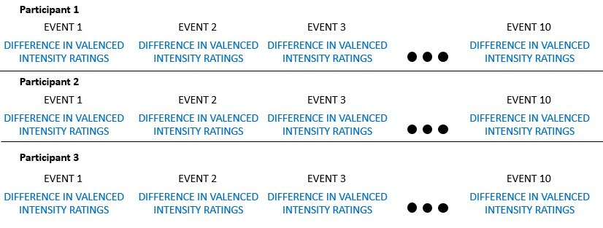
The valence of emotional experiences will trend more positive across events.
Tabachnick & Fidell (2018).
Notes:
And each participant, and then we regressed across events using a two-level hierarchical model. Our first-level unit and fixed effect were the Events and the second level, random effect were participants. The reason that we chose this over something like a standard linear regression is to better account for variance on each level. Our events did not occur in isolation and participants experienced these events them in groups. Using a multilevel model allows us to study this relationship without concerns for violating the independence of the data.
This will provide
Models of on a participant-by-participant level, as well as

Slide 46
The valence of emotional experiences will trend more positive across events.
MODEL
MODEL
MODEL
Tabachnick & Fidell (2018).
Notes:
And each participant, and then we regressed across events using a two-level hierarchical model.
Our first-level unit and fixed effect were the Events and

Slide 47
The valence of emotional experiences will trend more positive across events.
MODEL
MODEL
MODEL
Tabachnick & Fidell (2018).

Slide 48
Hypotheses
The valence of emotional experiences will trend more positive across events.
Participant 1
MODEL
Participant 2
MODEL
Participant 3
MODEL
Participant 50
MODEL
Notes:
Models of on a participant-by-participant level, as well as
Among all participants.

Slide 49
Hypotheses
The valence of emotional experiences will trend more positive across events.
Participant 1
MODEL
Participant 2
MODEL
All Participants
Participant 3
MODEL
MODEL
Participant 50
MODEL
Notes:
Among all participants.

Slide 50
Hypotheses
The valence of emotional experiences will trend more positive across events.
The valence of emotional experiences did significantly increase in positivity across events, b = 0.282, t(319.2): 2.12, p = 0.034.
Notes:
With this method, we found support for our hypothesis that valence did increase in positivity over time, although the effect size was modest.

Slide 51
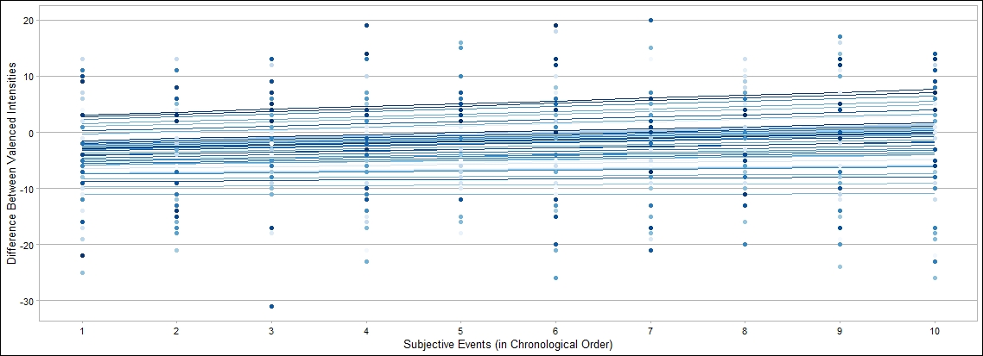
Change in Emotion Across Events
Difference Between Valenced Intensities
Subjective Events (in Chronological Order)
Notes:
On our X axis, we’ve charted the subjective events from 1 through 10 for each participant. The Y axis represents the difference between the valenced intensities. As the Y axis increases, the positivity of the event increases. A score of 0 would suggest that the positive and negative intensities were balanced with each other for that event.
We then see the trendlines on a participant by participant level, each with a slope and intercept unique to a participant.

Slide 52
Change in Emotion Across Events
Difference Between Valenced Intensities
Subjective Events (in Chronological Order)

Slide 53
Change in Emotion Across Events
Difference Between Valenced Intensities
Subjective Events (in Chronological Order)

Slide 54
Change in Emotion Across Events
Difference Between Valenced Intensities
Subjective Events (in Chronological Order)
Notes:
…Across participants, we see that small, but fairly consistent trend towards positivity, represented by the redline.

Slide 55
Change in Emotion Across Events
Difference Between Valenced Intensities
Subjective Events (in Chronological Order)
Notes:
…Across participants, we see that small, but fairly consistent trend towards positivity, represented by the redline. On average, individual's first emotional experience was more negative than positive, but each subsequent event was rated 0.2 points higher than the previous, culminating in a final event that was nearly equal in positive and negative intensity. Although it’s a modest effect size, it’s really cool to see the emotional experience change so much in 30 minutes. This might suggest that regulation is happening; that individuals are minimizing negative emotions and maximizing positive ones…

Slide 56
Hypotheses
Negative emotions are regulated with greater intensity than positive emotions.
Notes:
but is there a statistically significant difference how its occurring? That is to say: Do people attempt to regulate negative emotions moreso than positive ones.

Slide 57
Negative emotions are regulated with greater intensity than positive emotions.
EVENT 1
POSITIVE REGULATION INTENSITY RATING (1 – 7)
POSITIVE REGULATION INTENSITY RATING (1 – 7)
NEGATIVE REGULATION INTENSITY RATING (1 – 7)
NEGATIVE REGULATION INTENSITY RATING (1 – 7)
Notes:
Once again, we collected intensity scores, but used the regulation intensity this time, rather than the emotional intensity.
We separated by valence…

Slide 58
Negative emotions are regulated with greater intensity than positive emotions.
EVENT 1
POSITIVE REGULATION INTENSITY RATING (1 – 7)
NEGATIVE REGULATION INTENSITY RATING (1 – 7)
POSITIVE REGULATION INTENSITY RATING (1 – 7)
NEGATIVE REGULATION INTENSITY RATING (1 – 7)
Notes:
We separated by valence…
And calculated the mean positive regulation intensity by valence grouping.

Slide 59
Negative emotions are regulated with greater intensity than positive emotions.
EVENT 1
AVERAGE POSITIVE REGULATION INTENSITY RATING
AVERAGE NEGATIVE REGULATION INTENSITY RATING
Notes:
And calculated the mean positive regulation intensity by valence grouping.
We repeated the process for each event and each participant

Slide 60
Negative emotions are regulated with greater intensity than positive emotions.
EVENT 1
AVERAGE POSITIVE REGULATION INTENSITY RATING
AVERAGE NEGATIVE REGULATION INTENSITY RATING
EVENT 2
AVERAGE POSITIVE REGULATION INTENSITY RATING
AVERAGE NEGATIVE REGULATION INTENSITY RATING
EVENT 3
AVERAGE POSITIVE REGULATION INTENSITY RATING
AVERAGE NEGATIVE REGULATION INTENSITY RATING
EVENT 4
AVERAGE POSITIVE REGULATION INTENSITY RATING
AVERAGE NEGATIVE REGULATION INTENSITY RATING
EVENT 500
AVERAGE POSITIVE REGULATION INTENSITY RATING
AVERAGE NEGATIVE REGULATION INTENSITY RATING
Notes:
We repeated the process for each event and each participant
And then ran a within subjects ANOVA. In this case, temporal ordering wasn’t significant to our hypothesis and could be ignored.

Slide 61
Negative emotions are regulated with greater intensity than positive emotions.
EVENT 1
AVERAGE POSITIVE REGULATION INTENSITY RATING
AVERAGE NEGATIVE REGULATION INTENSITY RATING
EVENT 2
AVERAGE POSITIVE REGULATION INTENSITY RATING
AVERAGE NEGATIVE REGULATION INTENSITY RATING
EVENT 3
AVERAGE POSITIVE REGULATION INTENSITY RATING
AVERAGE NEGATIVE REGULATION INTENSITY RATING
EVENT 4
AVERAGE POSITIVE REGULATION INTENSITY RATING
AVERAGE NEGATIVE REGULATION INTENSITY RATING
EVENT 500
AVERAGE POSITIVE REGULATION INTENSITY RATING
AVERAGE NEGATIVE REGULATION INTENSITY RATING
WITHIN SUBJECTS ANOVA
Notes:
And then ran a within subjects ANOVA. In this case, temporal ordering wasn’t significant to our hypothesis and could be ignored.

Slide 62
Hypotheses
Negative emotions are regulated with greater intensity than positive emotions.
Negative emotions are more regulated than positive emotions, F(1,49) = 56.9, p < 0.001.
Notes:
The results suggest that individuals are more likely to regulate negative emotions than positive ones.

Slide 63
Average Intensity of Regulation Response By Valence Category
A Great Extent
***
F(1,49) = 56.9
P < 0.001
Average Regulation Attempt
CI's Represent 95% intervals
Notes:
Here we see the average intensity response on the Y axis again and average regulation attempt on the X axis. We’re looking at the average intensity of regulation response graphed. Although the premise seems commonsensical, the fact that even in a haunted house, in which an individual’s goal arguably might be to feel fear, we still see a tendency to apply strategies differently by valence is pretty interesting.

Slide 64
Hypotheses
The intensity of emotional experiences will decrease across events, independent of valence.
Notes:
For our last hypothesis, that intensity would decrease across events, it was a simpler process.

Slide 65
The intensity of emotional experiences will decrease across events, independent of valence.
EVENT 1
POSITIVE EMOTION INTENSITY RATING (1 – 7)
MEAN EMOTION
INTENSITY RATING
POSITIVE EMOTION INTENSITY RATING (1 – 7)
NEGATIVE EMOTION INTENSITY RATING (1 – 7)
NEGATIVE EMOTION INTENSITY RATING (1 – 7)
Notes:
We gathered all of the intensity scores for any emotion endorsed during an event, but did not separate by valence.
Instead mean emotion intensity ratings were calculated for each event.

Slide 66
The intensity of emotional experiences will decrease across events, independent of valence.
EVENT 1
EVENT 2
EVENT 3
EVENT 10
MEAN EMOTION
INTENSITY RATING
MEAN EMOTION
INTENSITY RATING
MEAN EMOTION
INTENSITY RATING
MEAN EMOTION
INTENSITY RATING
Notes:
And across individuals as well.

Slide 67
The intensity of emotional experiences will decrease across events, independent of valence.
Participant 1
EVENT 1
EVENT 2
EVENT 3
EVENT 10
MEAN EMOTION
INTENSITY RATING
MEAN EMOTION
INTENSITY RATING
MEAN EMOTION
INTENSITY RATING
MEAN EMOTION
INTENSITY RATING
Participant 2
EVENT 1
EVENT 2
EVENT 3
EVENT 10
MEAN EMOTION
INTENSITY RATING
MEAN EMOTION
INTENSITY RATING
MEAN EMOTION
INTENSITY RATING
MEAN EMOTION
INTENSITY RATING
Participant 3
EVENT 1
EVENT 2
EVENT 3
EVENT 10
MEAN EMOTION
INTENSITY RATING
MEAN EMOTION
INTENSITY RATING
MEAN EMOTION
INTENSITY RATING
MEAN EMOTION
INTENSITY RATING
Tabachnick & Fidell (2018).
Notes:
And across individuals as well. We ran this through another multi-level model using the same basic parameters as hypothesis 1.

Slide 68
Hypotheses
The intensity of emotional experiences will decrease across events, independent of valence.
Emotional intensity did not
decrease across events,
b = 0.025, t(319.2): 1.21, p = 0.23.
Notes:
Interestingly enough, we found that it did NOT decrease across events. This was really interesting for us, as the affective adaptation literature might suggest that habituation effects would show in the time within the house. So, we have to ask,
what’s going on?

Slide 69
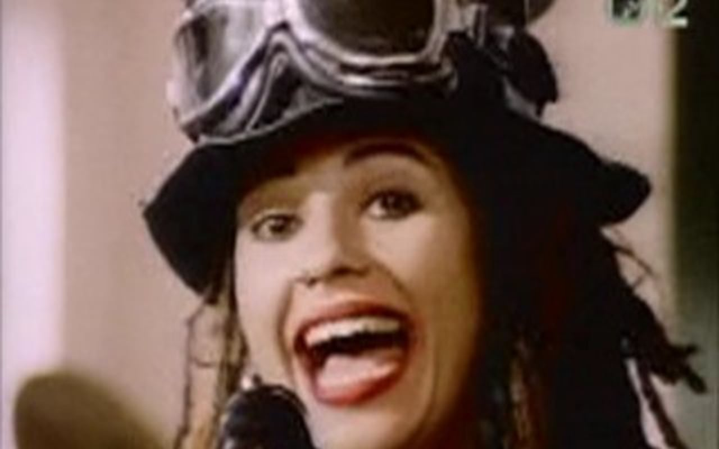
So what’s going on?
Variability
Nature of stimuli¹
Design of the experience
¹ Frederick & Loewenstein (1999).
Notes:
For one, the variability within the house likely makes it difficult for individuals to acclimate. Given that each section is themed and the nature of the stimuli changes with each theme, individuals may acclimate within section, but fail to generalize across sections. Furthermore, much of the stimulation within the house was auditory, and there’s a fairly robust literature documenting that auditory stimulation is extremely difficult to adapt to. Frederick and Loewenstein, for a fitting example, found that individuals more readily adapt to incarceration than unpleasant noises. Lastly, it’s a streamlined environment designed to be entertaining. If people weren’t having intense emotions throughout Terror Behind the Walls, there’d probably be a line of people at the door wanting their money back, so we could really just think of this as a manipulation check to test whether the actors deserve raises.

Slide 70
Review
The valence of emotional experiences did significantly increase in positivity across events.
Negative emotions are more regulated than positive emotions.
Emotional intensity did not decrease across events.
Notes:
So in conclusion, we found mixed support for our hypotheses thus far.

Slide 71
Limitations
Subjective chronological ordering
Time between exposure and data collection
Asking about regulation might prompt false responses
Imbalance in size of emotion category groupings
Self-selection bias
Notes:
But there are a number of limitations that these analyses suffer from.
For our first pass of analyses, we used the subjective ordering of events that participants had indicated in their post-exposure questionnaires. These may be subject to the effects of some memory biases.
Additionally, there was a notable delay between exposure and data collection, so the vividness of the emotional memories may have suffered from some degradation in that time.
It could also be the case that people didn’t regulate at all, but when asked, they felt obligated to provide a response that fit with what they thought researcher expectations may have been.
As previously noted, there is an imbalance in the size of the valence categories which influenced how our analyses are performed.
As is often the case with studies of this nature, there’s also the possibility of self-selection bias among participants, as participants were aware that the study would occur at Eastern State Penitentiary from the advertisements.

Slide 72
Limitations
Subjective chronological ordering
Time between exposure and data collection
Asking about regulation might prompt false responses
Imbalance in size of emotion category groupings
Self-selection bias
Haunted house is still an artificial setting that might not generalize to daily life
Notes:
Lastly, while the setting provides numerous benefits over where previous research has left off, it’s still not a perfect representation of regulation in the real world. But we’re still really just scratching the surface with this dataset.

Slide 73
Future Directions
Strategy choice as a function of emotional intensity
Notes:
So let me tell you where we want to take this research.
First and foremost, we hope to explore strategy choice as a function of emotional intensity.

Slide 74
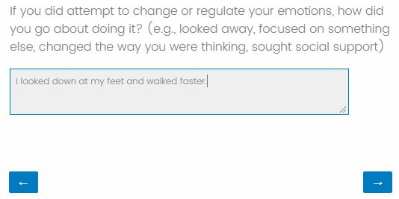
Measures
Event Experience and Ordering Questionnaire
Identify 10 events
Identify associated emotions
Identify intensity of emotion and attempt to regulate
Identify regulation strategies
Reorder items chronologically
Notes:
During the Qualtrics survey, participants also indicated how they attempted to regulate their emotions for each event.
By using independent, trained, and hypothesis-blind raters to categorize these responses, we can explore how intensity shapes strategy choice, and this is an important question

Slide 75
Emotion Regulation Strategies
The efficacy of different regulation strategies varies with situational demands.
Engagement strategies successfully modulate low-intensity emotional stimuli while disengagement strategies successfully modulate high-intensity emotional stimuli. ¹
ENGAGEMENT STRATEGIES
Example: Reappraisal
thinking about the stimulus in such a way to change its emotional meaning
In Context: Remembering that the people are actors
DISENGAGEMENT STRATEGIES
Example: Distraction
changing focus from the arousing stimulus to another stimulus
In Context: Looking down at your feet
¹ Sheppes et al. (2011).
Notes:
Because regulation strategies are not monolithic. Lab studies suggest that they have strengths and weaknesses just like any other tools that you might imagine. The efficacy of different strategies varies with situation demands. That is to say that not all strategies produce the same results as scenarios change. Sheppes and coauthors highlighted that strategies that require the regulator to engage with emotional content are more effective at modulating low-intensity emotional stimuli. Disengagement strategies better modulated high-intensity emotional stimuli. So what do we mean when we say engagement and strategies? Engagement strategies, like reappraisal, demand that the regulator cognitively analyzes the incoming stimuli to a greater degree than disengagement strategies, like distraction, do. Engagement strategies demand that you engage with the stimulus. In the context of this study, we might see reappraisal if a participant reported reminding themselves that the people behind the masks are just actors and not going to hurt them. An example of distraction might be choosing to look down at your feet rather than look at the actors.

Slide 76
Future Directions
Strategy choice as a function of emotional intensity
Forming Hypotheses for Additional Regulation Strategies
Notes:
So our hypotheses could stretch well beyond downregulating negative emotions. Given the high representation of positive emotions, it’s also to explore how and why individuals upregulate and the strategies used in those cases.

Slide 77
Future Directions
Strategy choice as a function of emotional intensity
Forming Hypotheses for Additional Regulation Strategies
ERQ and Metacognition
Notes:
One of the questionnaires captured before exposure, the ERQ, suggests strategy tendencies, and we’d like to test whether these match with data from these experiences. It could be the case that individuals think they’d use one strategy in theory, but in practice use another.

Slide 78
Future Directions
Strategy choice as a function of emotional intensity
Forming Hypotheses for Additional Regulation Strategies
ERQ and Metacognition
Chronological reordering and objective experience analyses
Notes:
Next, because the events in the house are consistent, we’re hoping to review the chronological ordering that individuals provided to determine how accurate it was and place it into an objective ordering. While all of our previous analyses limited us to analyzing the subjective experience of each participant, identifying unique events that pop up throughout multiple participant reports may allow us to also look at this data across participants as well.

Slide 79
Future Directions
Strategy choice as a function of emotional intensity
Forming Hypotheses for Additional Regulation Strategies
ERQ and Metacognition
Chronological reordering and objective experience analyses
Exploring association among additional factors
Age, Sex, Depressive Symptoms, Uncertainty Tolerance
Notes:
We’d also love to explore the association between our primary interests and additional factors using the experiential and pre-exposure surveys. Notably, the existing literature suggests that factors like age, sex, depressive symptoms, and uncertainty tolerance should all affect regulation strategy.

Slide 80
Future Directions
Strategy choice as a function of emotional intensity
Forming Hypotheses for Additional Regulation Strategies
ERQ and Metacognition
Chronological reordering and objective experience analyses
Exploring mediating and moderating factors
Age, Sex, Despressive Symptoms, Cognitive Overload, Uncertainty Tolerance
Merging these findings with physiological and memory data
Notes:
We additionally have a ton of memory data that the AML lab is working with, heartrate data that Joanne in our lab is working and audio recording that that we’re all parsing through. All of which will be incorporated down the line. Ultimately for our lab, the hope is that by …

Slide 81

Cognitive Change
Attentional Deployment
Situation Modification
“They’re just actors; they won’t really hurt me.”
“Well, those trees sure are interesting.”
“Can I help you guys find something? You look lost.”
Situation Selection
Response Modulation
“Time for me to get out of here.”
“This isn’t scary. I’m not scared. This isn’t scary. I’m not scared…”
Notes:
…Progressing through these future analyses,
we will better understand how and how often individuals engaged regulation strategies during Terror Behind the Walls.
And we can use this information, in combination with what we already know about emotion regulation strategies, to better help you answer the question…
Of how best to minimize the anxieties in your life
And maximize the joys. Thank you.

Slide 82
Cognitive Change
Attentional Deployment
Situation Modification
“They’re just actors; they won’t really hurt me.”
“Well, those trees sure are interesting.”
“Can I help you guys find something? You look lost.”
Situation Selection
Response Modulation
“Time for me to get out of here.”
“This isn’t scary. I’m not scared. This isn’t scary. I’m not scared…”
Notes:
And we can use this information, in combination with what we already know about emotion regulation strategies, to better help you answer the question…
Of how best to minimize the anxieties in your life
And maximize the joys. Thank you.

Slide 83
Cognitive Change
Attentional Deployment
Situation Modification
“I’m not going out to eat; I’m going out to see my friends”
“I can try to just focus on the conversation, rather than the food.”
“I could order something healthy from the menu.”
Situation Selection
Response Modulation
“I should just stay home and not go.”
“I should just eat pizza and
not care about my weight.”
Notes:
Of how best to minimize the anxieties in your life
And maximize the joys. Thank you.

Slide 84
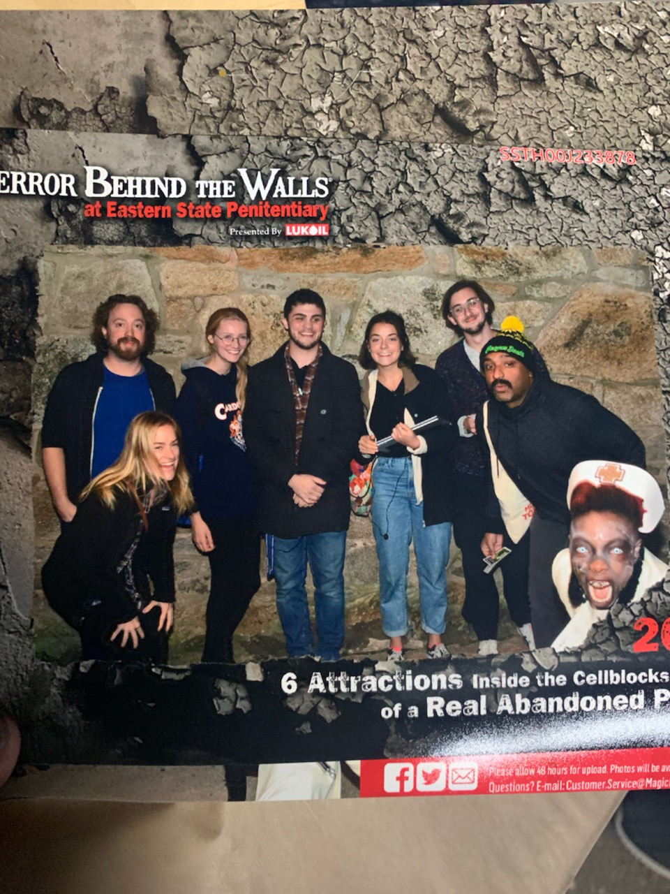

Sincere Appreciation to:
(Organized Alphabetically)
SAN Lab
Adhya Gowda
Bijal Patel
Chelsea Helion
Esha Kadakia
Joanne Stasiak
AML Lab
Bushra Tanriverdi
Dave Gregory
Deepu Murty
Devlin Eckardt
Emily Cowan
Elizabeth Eberts
Jane Rothrock
Joy Gonzalez
Kaitlyn O’Neill
Karen Shen
Katelyn Cliver
Kathryn Lockwood
Matthew Fain
Nicole Gonzalez
Sam Reisman
Vandanna Haripersaud
Notes:
Lastly, I just want to make sure to thank the people that helped me with this presentation and helped us build this project, between running sessions, data collections, scans, and analyzing. It really took a small army to pull off, and there were a lot of people that helped in big and small ways, so thank you to all of the members of the SAN Lab and the AML Lab.

Slide 85
QUESTIONS?

Slide 86
If you see this slide
You’ve gone too far!!!

Slide 87
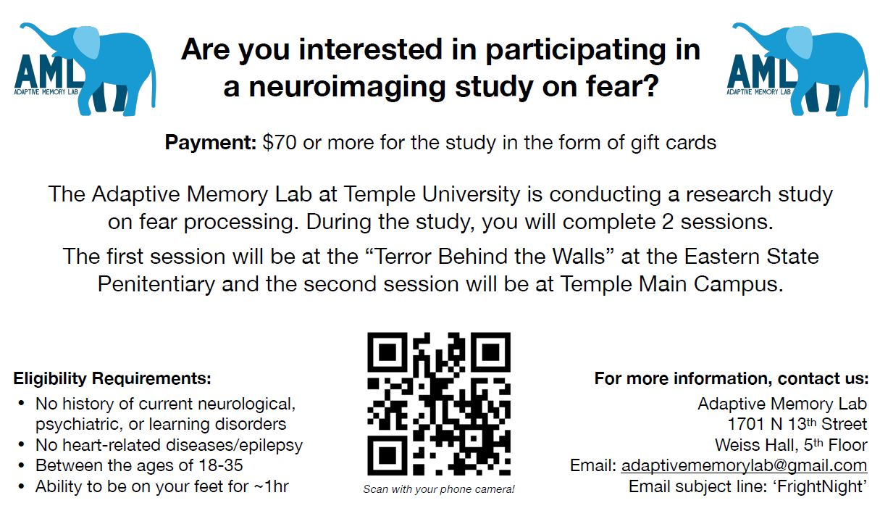
Notes:
Participants were aware that this was a study on fear and that it would be occurring at Eastern State Penitentiary.

Slide 88


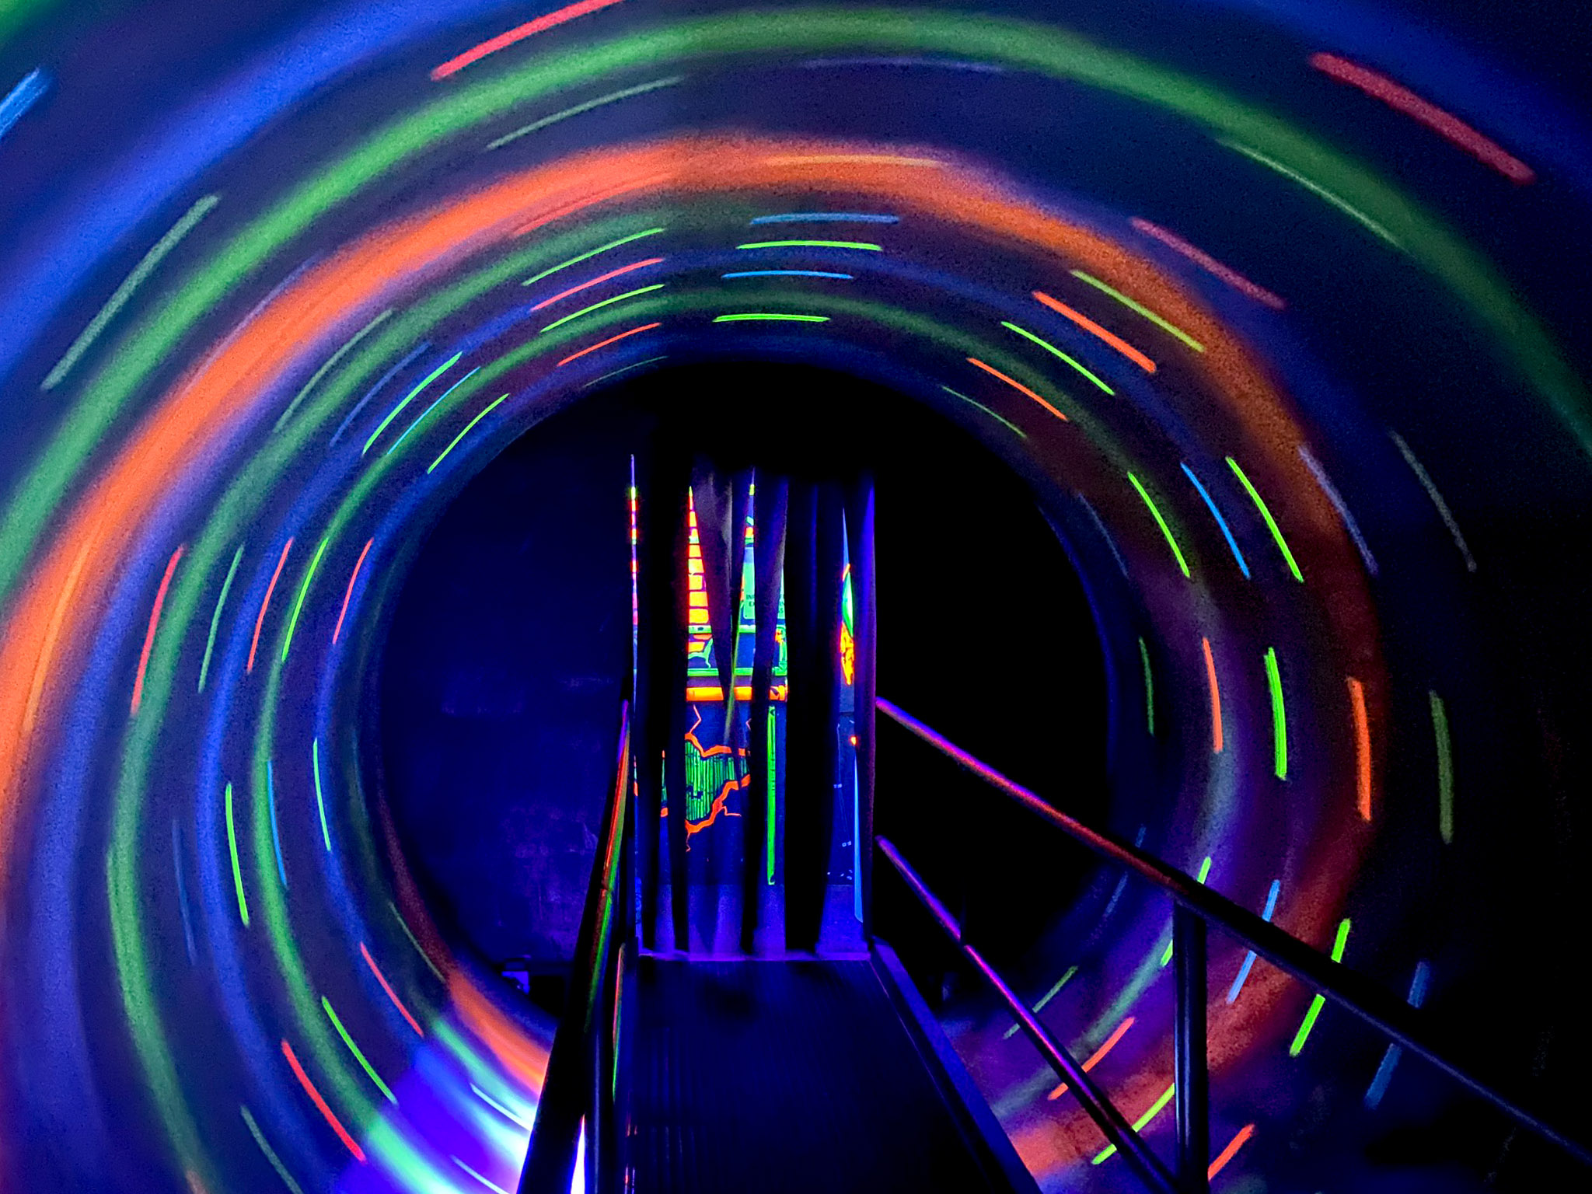


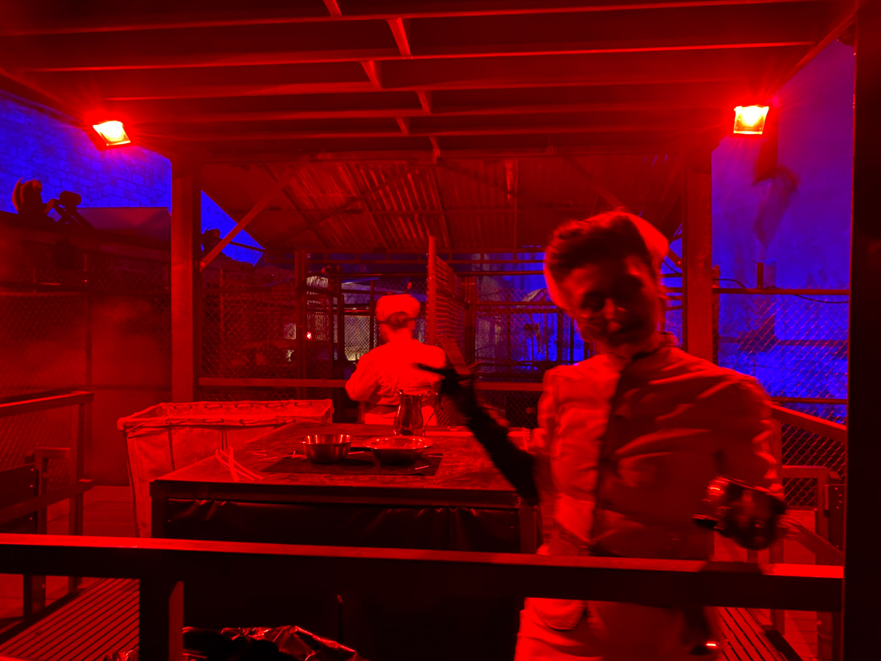
Notes:
Terror Behind the Walls contains an ample and varied amount of auditory, visual, and sensory stimuli that participants experienced as they progressed through. Even while waiting between sections, inattentive patrons are kept on their toes by skulking actors. In spite of that variability within the building, the events of the night were kept highly consistent across groups. To better ensure consistency, the directors even allowed our group to enter before patrons on most nights, so that actors were in the same positions. Researchers documented any deviations from the norm using their own audio recording devices.

Slide 89

Pre-Exposure Measures
Demographics
E.g., Age, ethnicity, education
Beck Depression Inventory – II
12 Items, α = 0.91, test-retest: r =0.93 ¹
Emotion Regulation Questionnaire
10 Items, α = 0.80 – 0.90 ²
Intolerance of Uncertainty Scale
27 Items, α = 0.94, test-retest: r =0.74 ³
State-Trait Anxiety Inventory
40 Items, α = 0.86 – 0.95, test-retest: r = 0.65- 0.75 ⁴
Interpersonal Relations Questionnaire
17 Items
¹ Beck & Steer (1984); ² Gross (2002); ³ Buhr & Dugas (2002); ⁴ Spielberg (1989).
Notes:
And our pre-exposure questionnaires captured these well, through the Beck Depression Inventory, the Intolerance to Uncertainty Scale, The State-Trait Anxiety Inventory, and Interpersonal Relations Questionnaire.

Slide 90
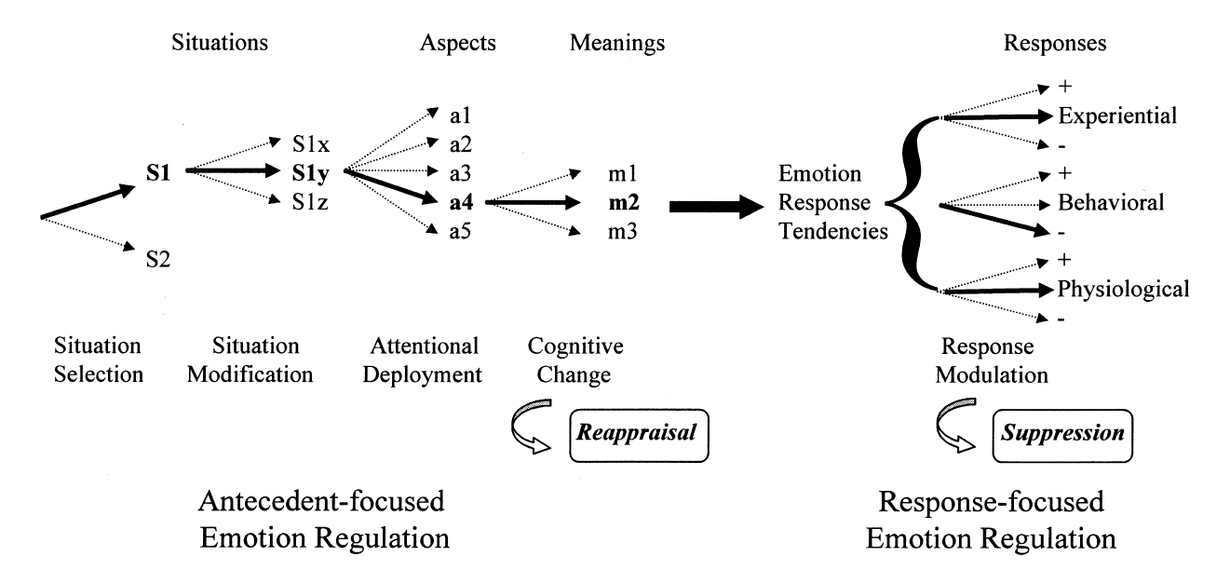
Emotion Regulation Strategies
The efficacy of different regulation strategies varies with situational demands.
Engagement strategies successfully modulate low-intensity emotional stimuli while disengagement strategies successfully modulate high-intensity emotional stimuli. ¹
²
¹ Sheppes et al. (2011).
² Gross (2002).
Notes:
So why does this distinction matter? Different regulatory strategies modify the cognitive processing of emotional information at different attentional stages. Gross’s Process Model of Emotional Regulation posits this.
Here we have a visual representation of the Process Model. The number of options within each stage and the bolded arrows are arbitrary. However, what this notably underscores is that there are five stages at which regulatory strategies can act, divided into pre-response groupings…
And post-response groupings…
And that their temporal ordering is a factor in their success.

Slide 91
Emotion Regulation Strategies
The efficacy of different regulation strategies varies with situational demands.
Engagement strategies successfully modulate low-intensity emotional stimuli while disengagement strategies successfully modulate high-intensity emotional stimuli. ¹
²
¹ Sheppes et al. (2011).
² Gross (2002).
Notes:
Here, we see that attentional deployment, which distraction is a form of…
Operates earlier in the attention stream than does cognitive change, of which reappraisal is a form.
This allows the regulator to dedicate fewer resources in order to regulate their emotions successfully.

Slide 92
Emotion Regulation
The efficacy of different regulation strategies varies with the cognitive resources available.
Selection, Optimization, & Compensation Framework for Emotional Regulation (SOC-ER)¹
Choosing to use strategies that are reasonable given available resources
Putting time and effort into practicing these strategies
Pivoting to different strategies when the current strategy is unsuccessful.
¹ Opitz et al. (2012).
Notes:
A second point is that the efficacy of strategies also varies as a function of the cognitive resources that a person has available. The Selection, Optimization, and Compensation Framework for Emotional Regulation proposes that successful regulation can be achieved by choosing to use strategies that are reasonable given available resources, putting time and effort into practicing these strategies, and pivoting to different strategies when the current strategy is unsuccessful. It could perhaps be more succinctly put as, “Do the best with what ya got”. As such, there are a number of studies highlighting the effects that working memory capabilities, either as a function of manipulation, age, or another variable, have on the success of emotion regulation. Specifically, because disengagement strategies require fewer cognitive resources, they are more successfully implemented than engagement strategies for individuals with limited working memory capabilities.

Slide 93
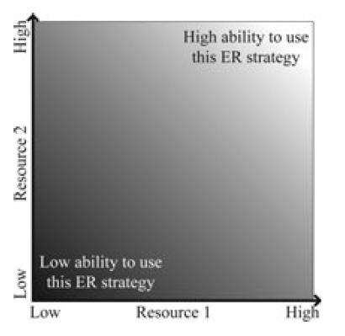
Emotion Regulation
The efficacy of different regulation strategies varies with the cognitive resources available.
Disengagement strategies successfully modulate emotional stimuli when working memory capabilities are low, in contrast to engagement strategies. ¹
2
Social Support
Working Memory
¹ Ilan et al. (2019).
² Opitz et al. (2012).
Notes:
The visualization provides another way in which to think about the SOC-ER framework. The two axes represent two different resources. As you move further from the lower left corner, the availability of the given resource increases. As availability increases, so does one’s ability to use the given strategy.
Let’s say, for example, we wanted to look at working memory and social support.
If we were to graph the resources available to a lonely individual with high working memory that wanted to use social support as a strategy, represented by the red box, we see that their ability to use that strategy is somewhat hindered. However,

Slide 94
Emotion Regulation
The efficacy of different regulation strategies varies with the cognitive resources available.
Disengagement strategies successfully modulate emotional stimuli when working memory capabilities are low, in contrast to engagement strategies. ¹
2
Social Support
Working Memory
¹ Ilan et al. (2019).
² Opitz et al. (2012).
Notes:
An individual with slightly less working memory, but far greater access to support would be enjoy a greater ability to utilize that strategy successfully.

Slide 95
Works Cited

Slide 96
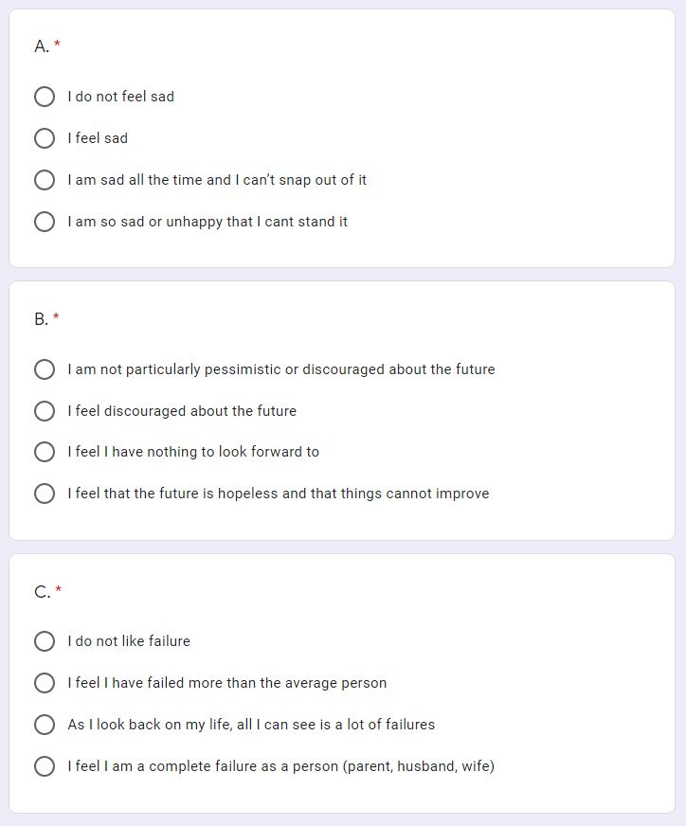
Measures
Demographics
E.g., Age, ethnicity, education
Beck Depression Inventory – II
12 Items, α = 0.91, test-retest: r =0.93 ¹
Emotion Regulation Questionnaire
10 Items, α = 0.80 – 0.90 ²
Intolerance of Uncertainty Scale
27 Items, α = 0.94, test-retest: r =0.74 ³
State-Trait Anxiety Inventory
40 Items, α = 0.86 – 0.95, test-retest: r = 0.65- 0.75 ⁴
Interpersonal Relations Questionnaire
17 Items
¹ Beck & Steer (1984); ² Gross (2002); ³ Buhr & Dugas (2002); ⁴ Spielberg (1989).
Notes:
Measures captured in the pre-exposure questionnaire include a basic demographics questionnaire, and several well established, reliable surveys. These include
The Beck Depression Inventory, recording depressive symptoms within the past two weeks, such as
Sadness
Pessimism
And Feelings of Failure.

Slide 97
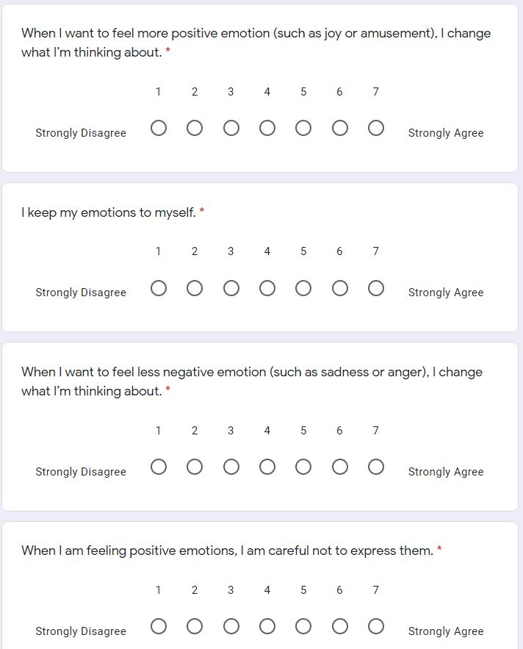
Measures
Demographics
E.g., Age, ethnicity, education
Beck Depression Inventory – II
12 Items, α = 0.91, test-retest: r =0.93 ¹
Emotion Regulation Questionnaire
10 Items, α = 0.80 – 0.90 ²
Intolerance of Uncertainty Scale
27 Items, α = 0.94, test-retest: r =0.74 ³
State-Trait Anxiety Inventory
40 Items, α = 0.86 – 0.95, test-retest: r = 0.65- 0.75 ⁴
Interpersonal Relations Questionnaire
17 Items
¹ Beck & Steer (1984); ² Gross (2002); ³ Buhr & Dugas (2002); ⁴ Spielberg (1989).
Notes:
The ERQ, measuring emotion regulation inclinations using questions such as
“When I want to feel more positive emotion (such as joy or amusement), I change what I’m thinking about”, and
“I keep my emotions to myself”.

Slide 98
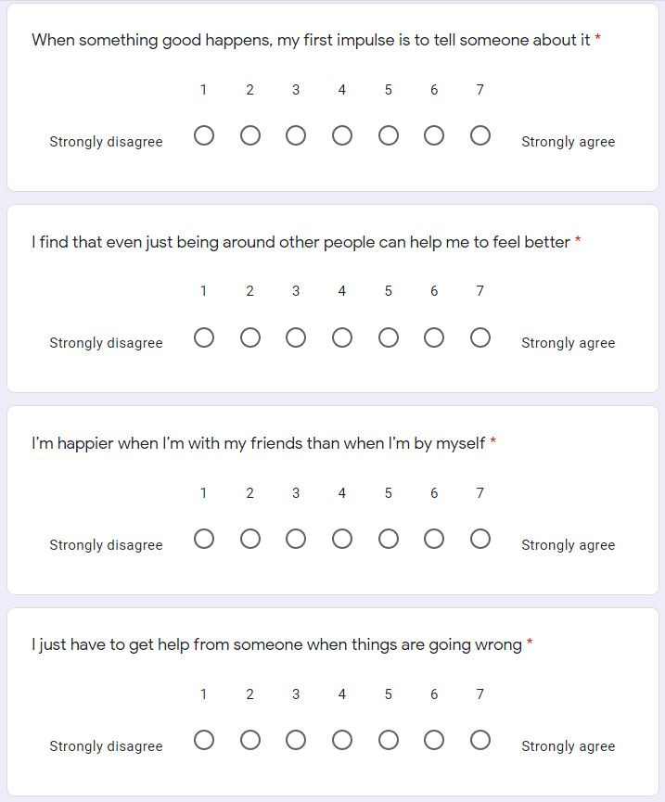
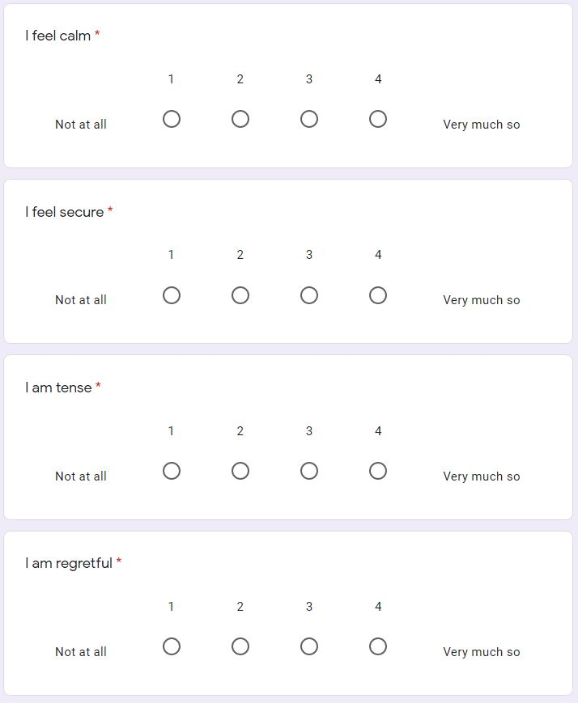
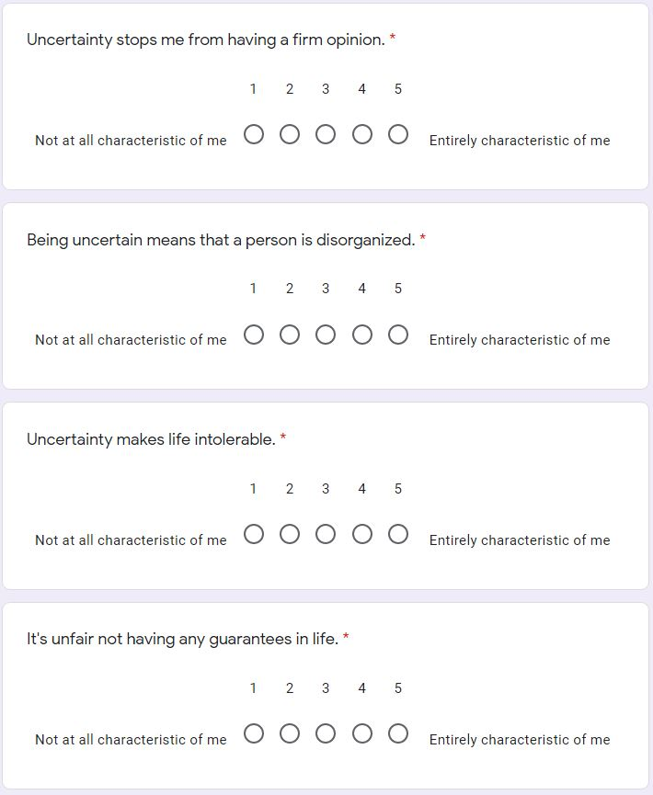
Measures
Demographics
E.g., Age, ethnicity, education
Beck Depression Inventory – II
12 Items, α = 0.91, test-retest: r =0.93 ¹
Emotion Regulation Questionnaire
10 Items, α = 0.80 – 0.90 ²
Intolerance of Uncertainty Scale
27 Items, α = 0.94, test-retest: r =0.74 ³
State-Trait Anxiety Inventory
40 Items, α = 0.86 – 0.95, test-retest: r = 0.65- 0.75 ⁴
Interpersonal Relations Questionnaire
17 Items
¹ Beck & Steer (1984); ² Gross (2002); ³ Buhr & Dugas (2002); ⁴ Spielberg (1989).
Notes:
The IUS, measuring Uncertainty intolerance, using questions such as
Uncertainty stops me from having a firm opinion, and
Uncertainty makes life intolerable
The state trait anxiety inventory, which can be used to diagnose anxiety and to distinguish it from depressive syndroms. Participants endorse statements such as…
I feel calm, and
I feel secure.
Lastly, the IRQ, measuring interpersonal skills, with statements such as
I’m happier when I’m with my friends than when I’m by myself
And I just have to get help from someone when things are going wrong.

Slide 99
Emotions Endorsed By Valence Group, Adj. By Group Size

Slide 100
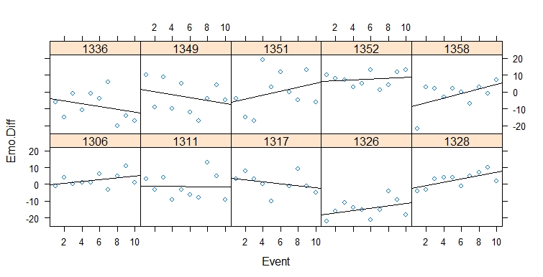
Change in Emotion Across Events
Difference Between Valenced Intensities
Subjective Events (in Chronological Order)

Slide 101
Hypotheses
Strategy choice will be a function of emotional intensity.
The likelihood of engaging Response Modulation increased with emotional intensity, but Cognitive Change and Attentional Deployment did NOT.
Notes:
Lastly, we examined how likely strategy choice would be a function of emotional intensity. Specifically, we hypothesized, based on the previous research, that low-intensity emotional experiences were more likely to be regulated by Cognitive Change strategies and that as intensity increases, disengagement strategies like response modulation and attention deployment would be more likely to be used.
In order to do this, we trained two independent raters naïve to the study hypotheses to categorize regulation description responses to events based upon our three hypotheses. Responses in which an alternative strategy was determined to be used were discarded. After independent rating, our raters achieved 50% agreement. All descriptions with disparate categorizations were reviewed and a compromise was achieved between the two independent raters. Using these categorizations, each event received a binary coding indicating whether a specific strategy was implemented. Average emotional intensity was calculated and a binary logistic regression was performed providing estimates of how strong a predictor emotional intensity was in implementing a specific strategy.
However, what we found was that emotional intensity did not predict either cognitive change or attentional deployment. Response modulation was significantly predicted by increasing emotional intensity, but was relatively rarely implemented.

Slide 102
Notes:
Of nearly 210 events, only 3%, or 6 events, reported utilizing response modulation. Attentional Deployment was far and away the most popular choice for regulation strategy, but again it occurred independently of emotional intensity.

Slide 103
Average Intensity of Emotion and Regulation Responses By Valence Category
A Great Extent
Not At All
Notes:
Once again, we have the likert scale that we used to assess the intensity of emotions on the Y axis.
And the graph we’d previously seen highlighting the difference in intensities by valence. The reason I bring this back is because we just saw that the average experience was, at best, neutral, and, at worst, negative. Yet, individual positive emotions tend to be more intense that negative ones. Furthermore
On average, we see the attempts to regulate them are weaker or less intense, as you might expect.

Slide 104
So what’s going on?
Untrained, strategy-naïve population
Unaccounted for factors
Notes:
So again, we need to ask, why did our hypotheses differ so significantly from these outcomes. One explanation may be that our populations differed significantly. In most of the previous literature, participants were trained in strategies and were aware that they should implement them. Our participants were not explicitly asked to implement any regulation strategies, in order to better mimic real world regulation. These hypotheses were formulated on this “best-case-scenario” type situation. As a result, it may just be the case that regulation outside of the lab is influenced be a number of factors besides intensity. Which leads me to the next steps that we would like to take with these analyses.

Slide 105
Future Directions
Strategy choice as a function of emotional intensity
Chronological reordering and objective experience analyses
Exploring mediating and moderating factors
Age, Sex, Depressive Symptoms, Cognitive Overload, Uncertainty Tolerance
Merging these findings with physiological and memory data
Forming Hypotheses for Additional Regulation Strategies
Longitudinal Data Collection
ERQ and Metacognition
Notes:
We’d also love to explore mediating and moderating factors using the experiential and pre-exposure surveys. Notably, the existing literature suggests that factors like age, sex, depressive symptoms, and uncertainty tolerance should all affect regulation strategy. We could

Slide 106
Emotion Regulation Strategies
The efficacy of different regulation strategies varies with emotional goals.
The emotional goals that people pursue and the strategies that they select to attain them are inherently connected.¹
Assessing the best fitting strategy for the situation is crucial for ideal outcomes.^{2,3,4}
TAKE HOME POINT
¹ Millgram et al. (2019).
² Shafir et al. (2016).
³ Webb et al. (2012).
⁴ Sheppes et al. (2015).
Notes:
Lastly, the efficacy of different regulation strategies varies with emotional goals. Certain strategies, like rumination, function really well to upregulate your emotional response. Sitting, stewing, focusing on an emotional stimuli tends to increase your feelings towards it. Other strategies, like distraction, work really well to downregulate. Choosing rumination when you should choose distraction will result in maladaptive behaviors.
In summation, the big take away point is that assessing the best fitting strategy for the situation is crucial for ideal outcomes!

